Slide 1
Homestead High School Book Club
First Meeting
September 4th, 2014

Slide 2
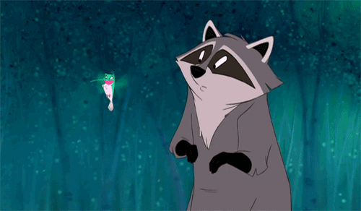
Who We Are
Ashley Helfinstein (11) Co-President
Hannah Goh (11) Co-President
Heather Huntley (11) Secretary-Treasurer
Nice to Meet You!

Slide 3

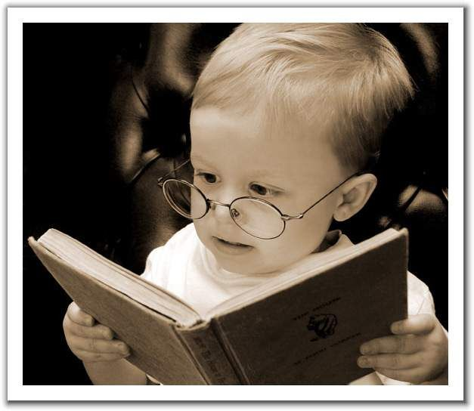
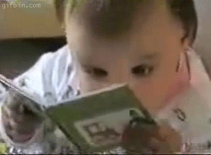
Purpose
Express your inner reader!
Recommend AMAZING books for you all!
Discuss the awesome world of books!

Slide 4

Future Activities
Movie Socials
Book Drives
Book Reviews
Book Exchange
Possible T-Shirts
A suggested $3 donation can help us with these events in the future!

Slide 5
Recommended Books!
An Abundance of Katherines, a young adult novel by John Green
Paper Towns, a young adult novel by John Green
Eleanor and Park, a young adult novel by Rainbow Rowell
The Unbecoming of Mara Dyer, a murder-mystery by Michelle Hodkin
Wither, a dystopian novel by Lauren DeStefano
Panic, a dystopian book by Lauren Oliver
Fangirl, a contemporary novel by Rainbow Rowell
Outliers, a non-fiction by Malcolm Gladwell
Predictably Irrational, a nonfiction by Dan Ariely

Slide 6
Any More Recommendations?

Slide 7
What Genres Do You Like?

Slide 8
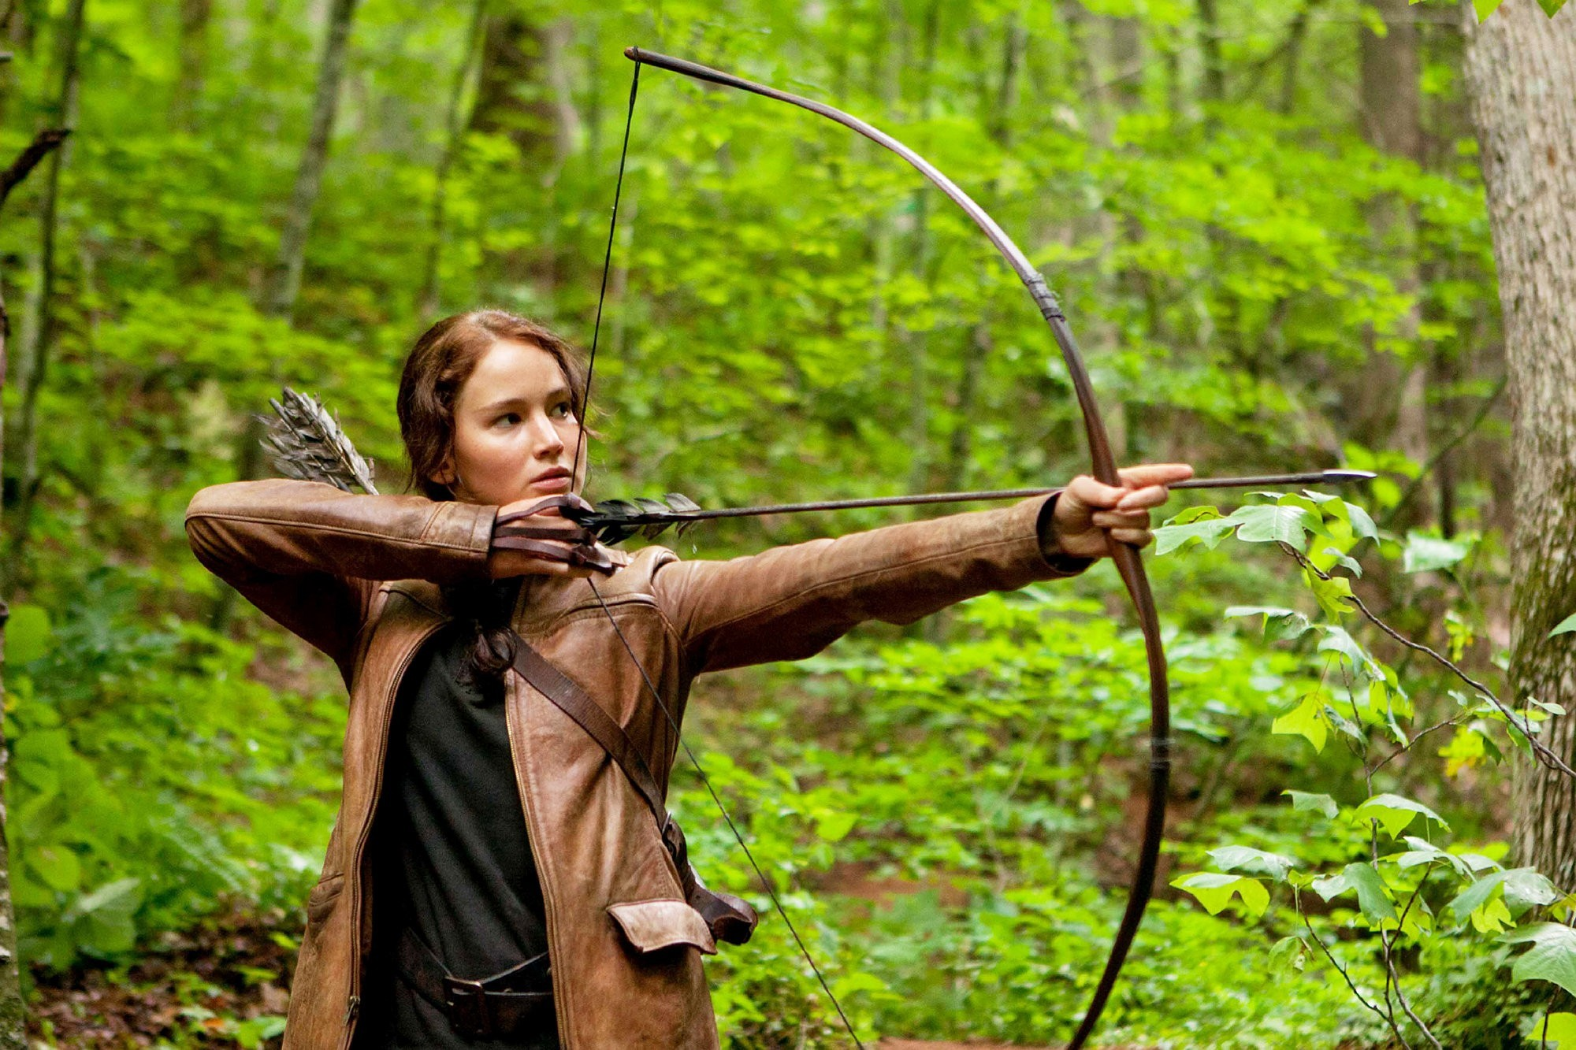
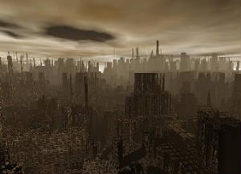

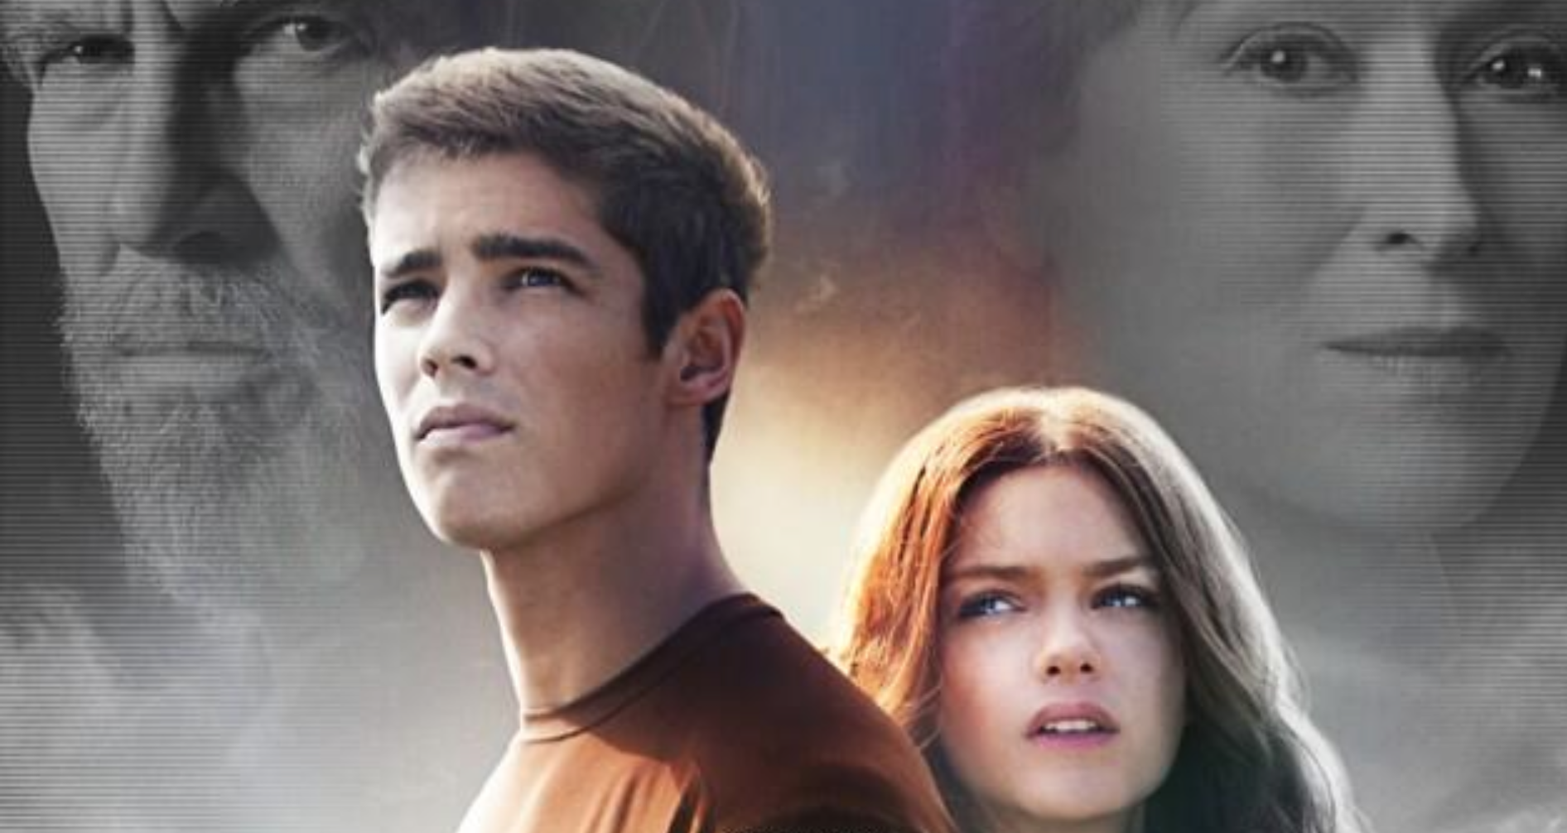
And our theme for next week is…
Opposition!

Slide 9


And the Winner of the Raffle is..
Congratulations!

Slide 10




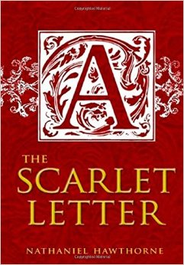
Quote Matching Game!
She had wandered, without rule or guidance, in a moral wilderness; as vast, as intricate and shadowy, as the untamed forest
Yes frosting. The final defense of the dying.
I have a theory that selflessness and bravery aren’t all that different.
If I speak, I am condemned. If I stay silent, I am damned!
After you get stung, you can’t get unstung no matter how much you whine about it.

Slide 11
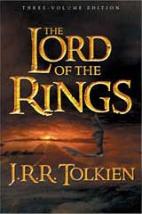
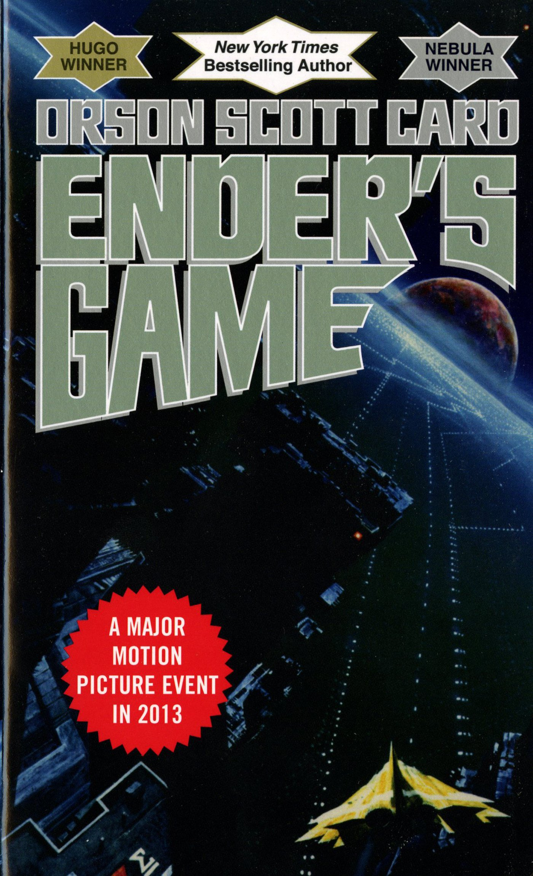



I’m in love with you, and I’m not in the business of denying myself the simple pleasure of saying true things.
Being human totally sucks most of the time. Videogames are the only thing that make life bearable.
And some things should not have been forgotten were lost. History became legend. Legend became myth. And for two and a half thousand years, the ring passed out of all knowledge.
Just because it’s taken you three years to notice, Ron, doesn’t mean no one else has spotted I’m a girl!
In the moment when I truly understand my enemy, understand him well enough to defeat him, then in that very moment I also love him. I think it’s impossible to really understand somebody, what they want, what they believe and not love them the way they love themselves. And then, in that very moment when I love them… I destroy them.

Slide 12
Thanks for coming to our first meeting!
Come to our next meeting on October 2nd to discuss our first theme: Opposition!

